Slide 1
Ligand Docking with Autodock4

Slide 2
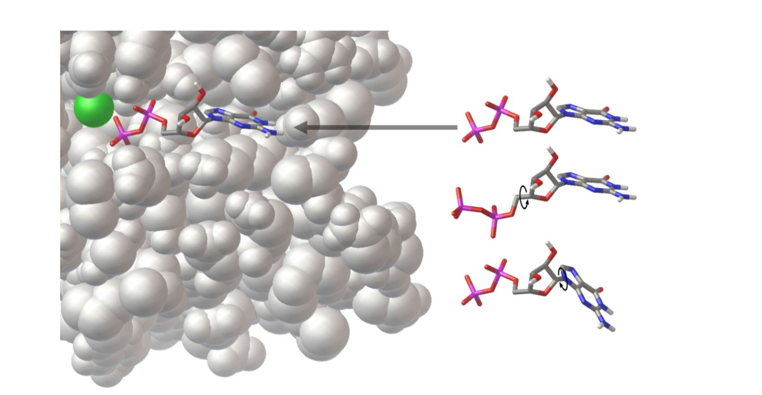
What is Docking?
Given the 3D structure of a two molecules trying to compute the energy of interaction.

Slide 3
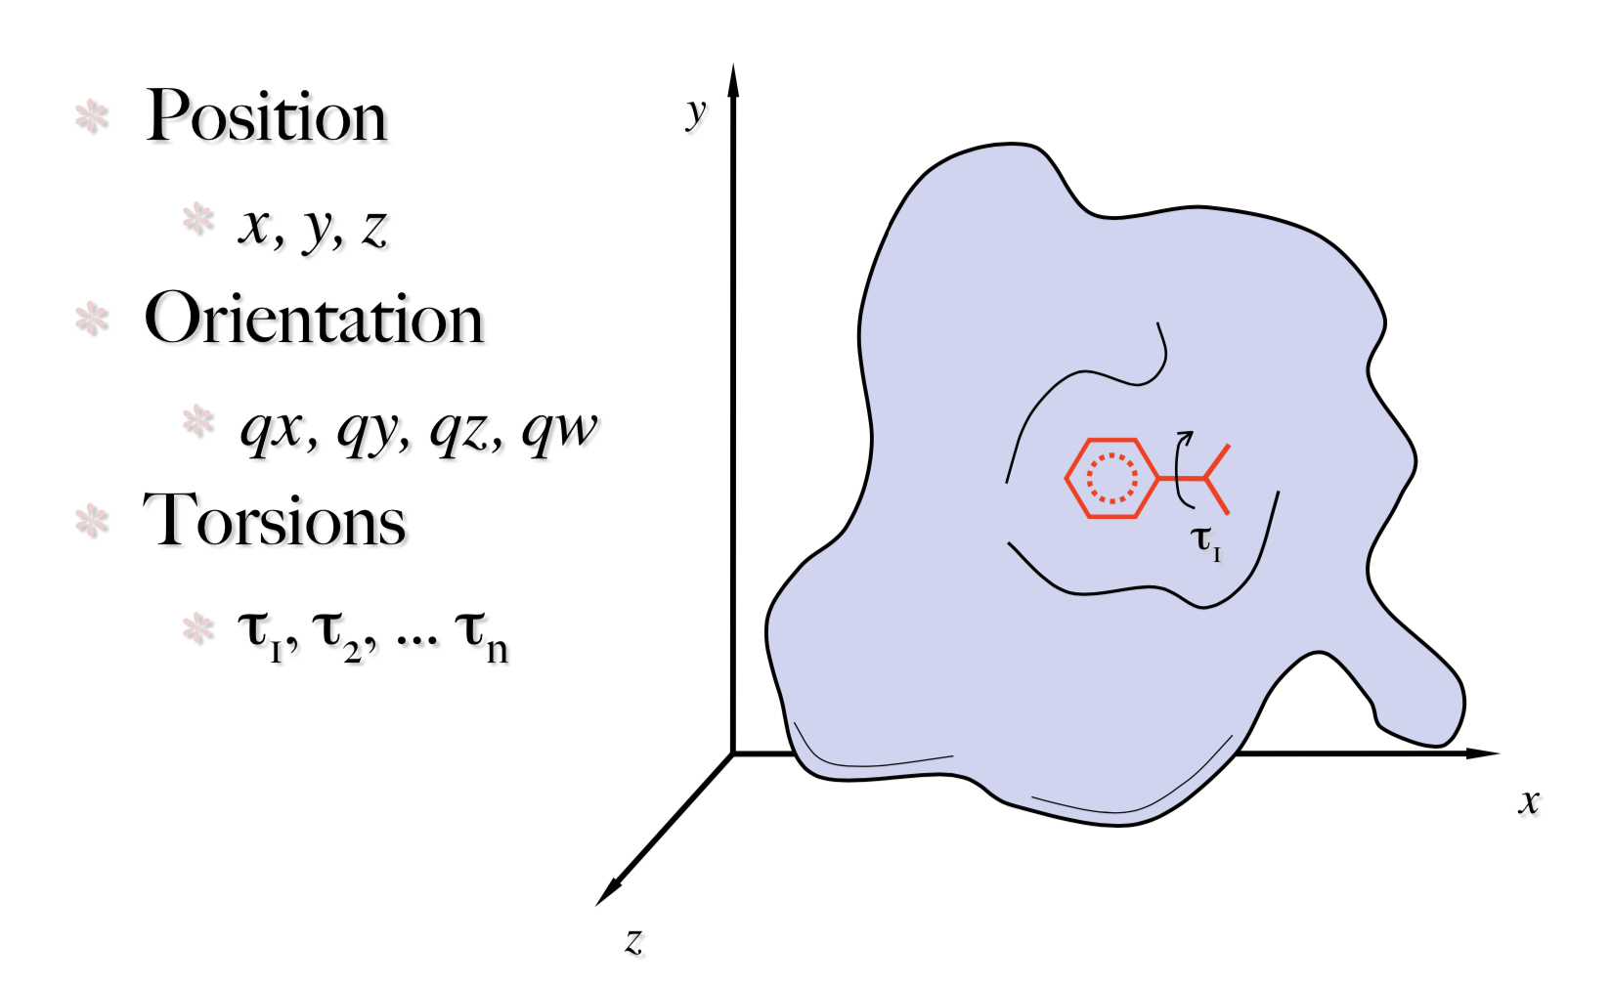
Defining the dock location and degrees of freedom

Slide 4
Components of docking
Score Functions
Predicting the energy of a particular protein conformation
Often a trade-off between speed and accuracy
Search Methods
Finding the optimal conformation of the protein and ligand
Evaluating the results
What can we learn from the output and how can this inform drug design

Slide 5
Components of Autodocks scoring function

Slide 6
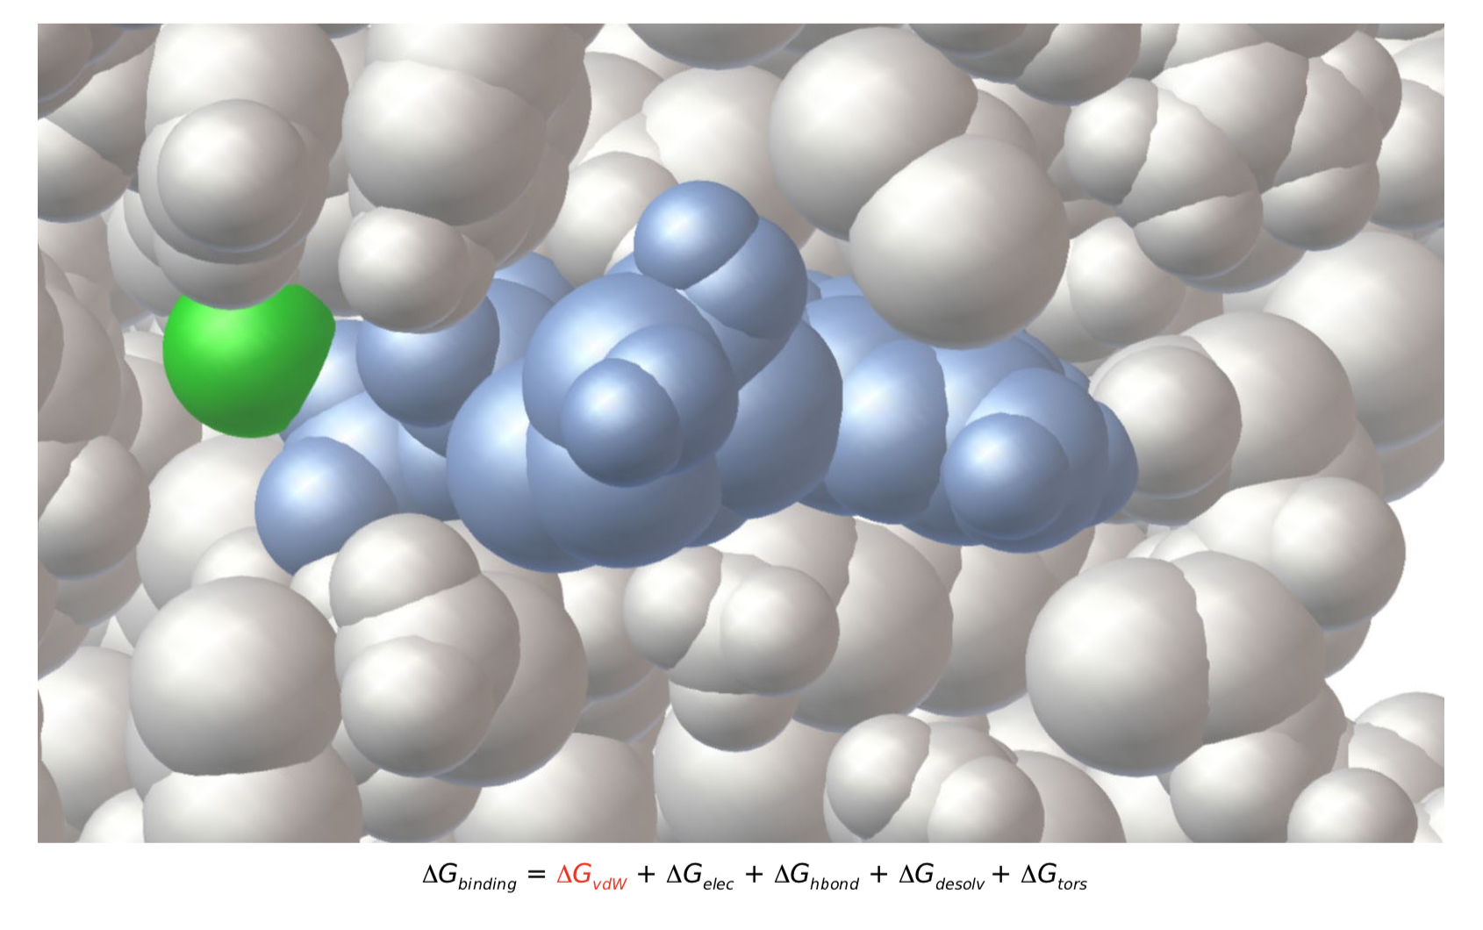
Dispersion/Repulsion

Slide 7
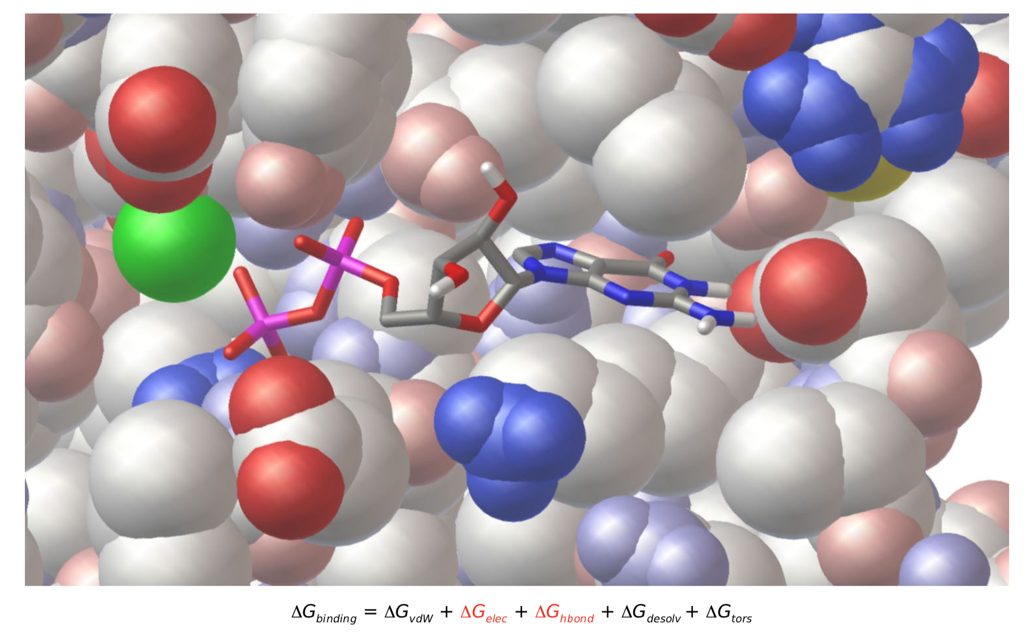
Electrostatic and hydrogen bonds

Slide 8
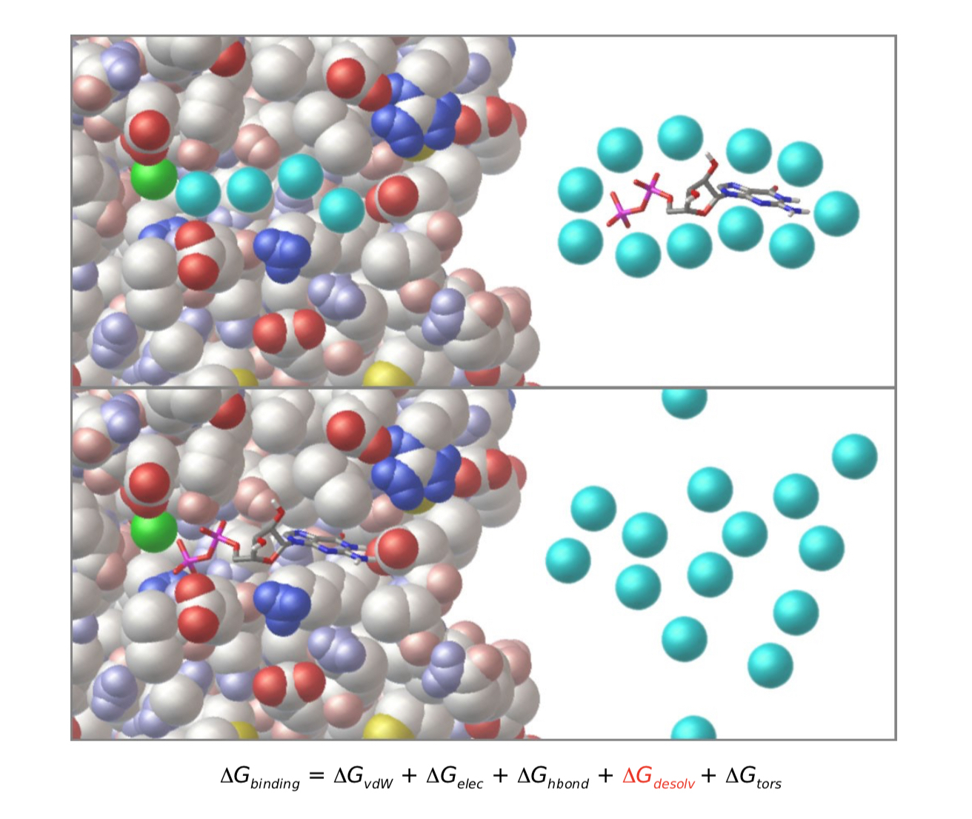
Electrostatic and hydrogen bonds

Slide 9
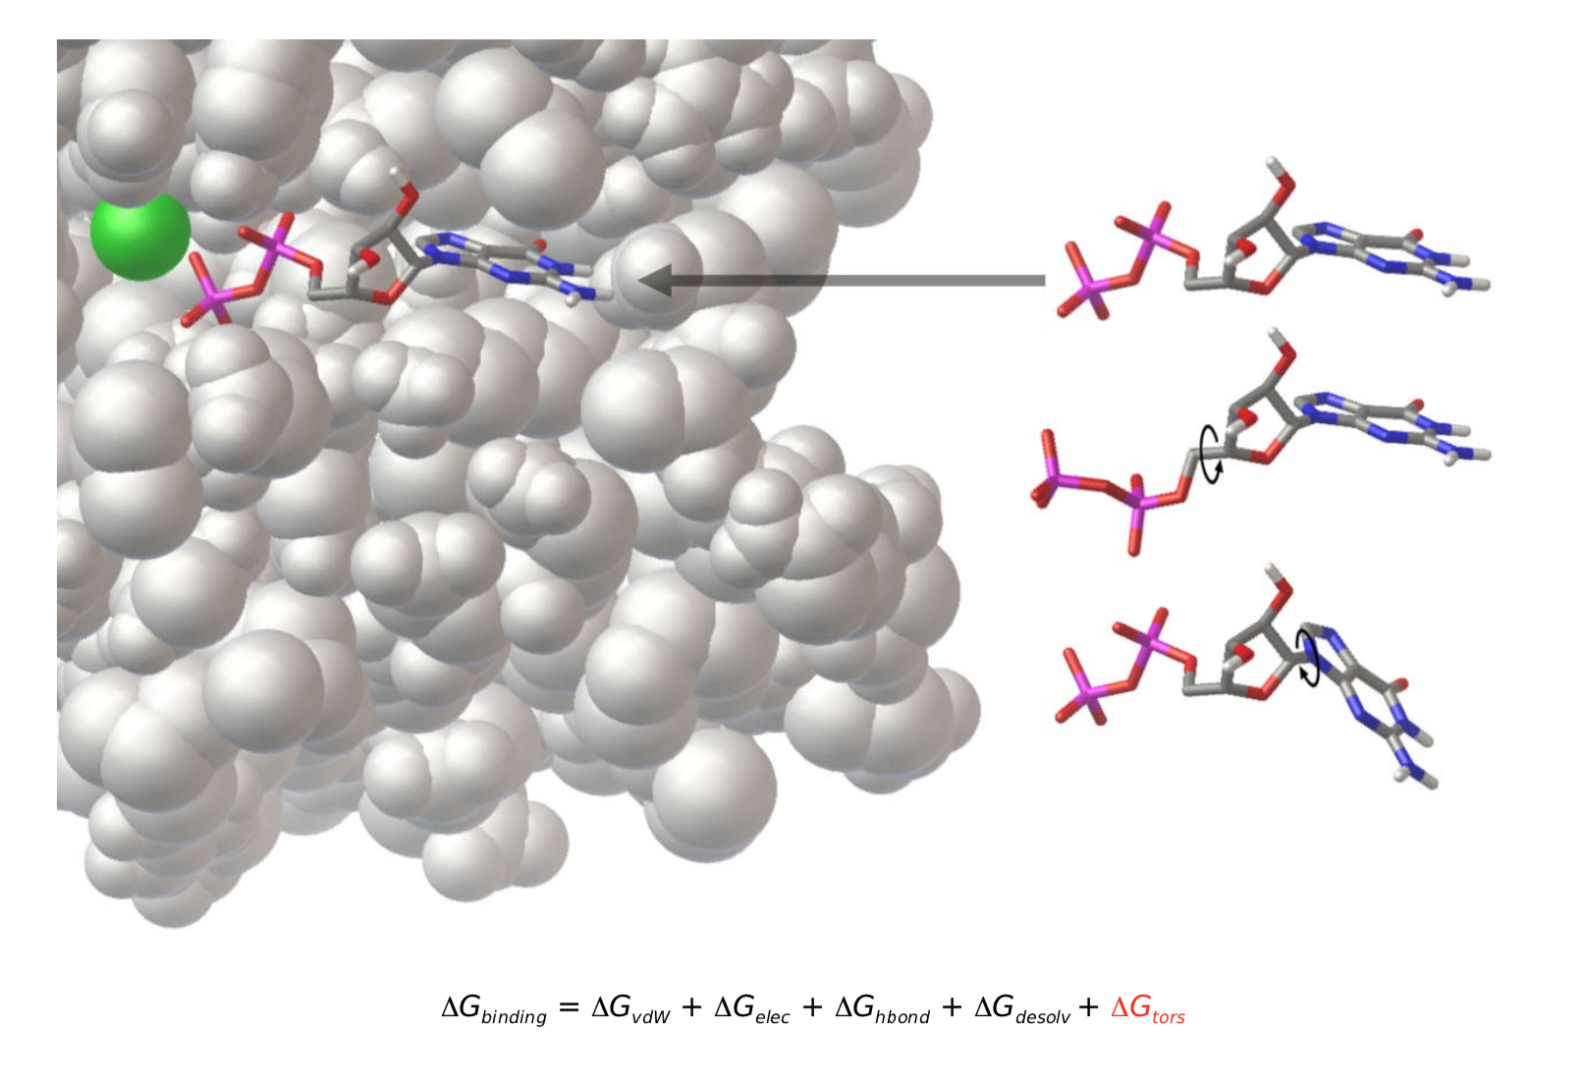
Torsional Entropy

Slide 10
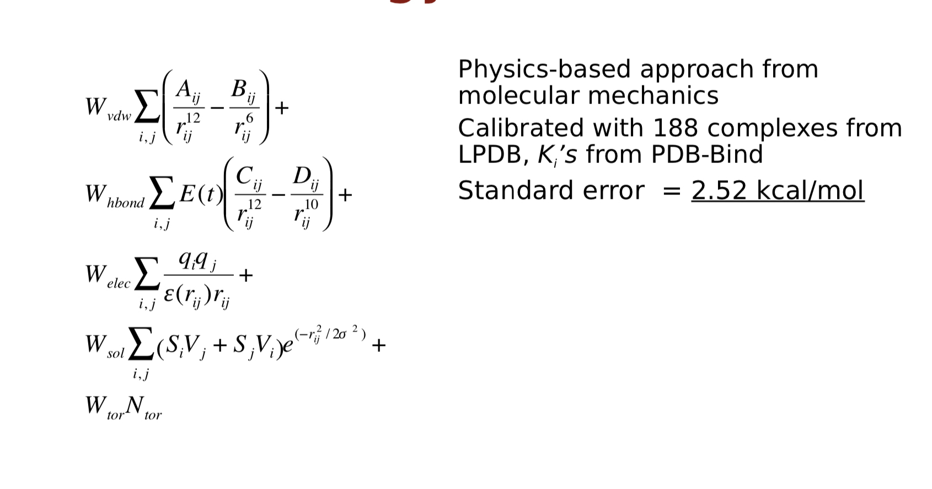
Autodock’s empirical free energy force field

Slide 11
Autodock’s empirical free energy force field

Slide 12
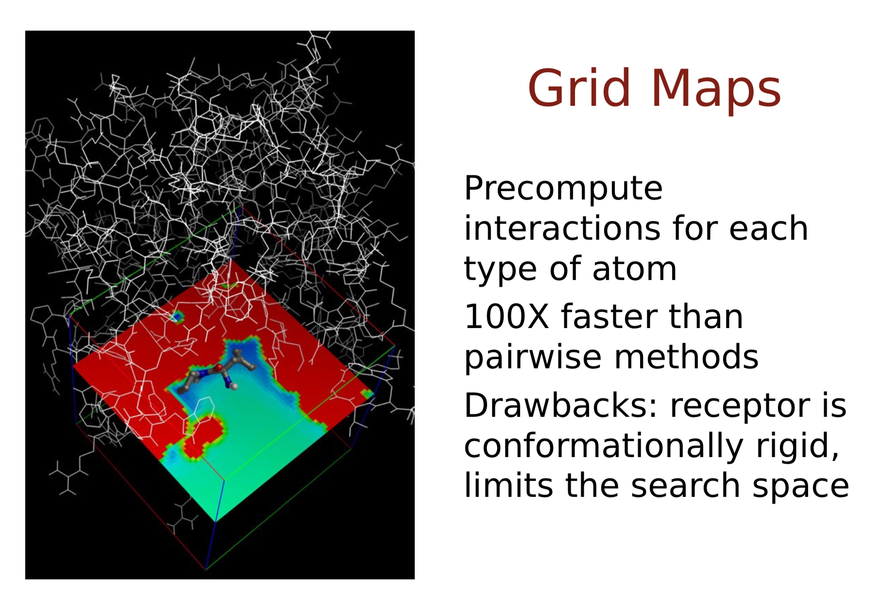
Energy Grids

Slide 13
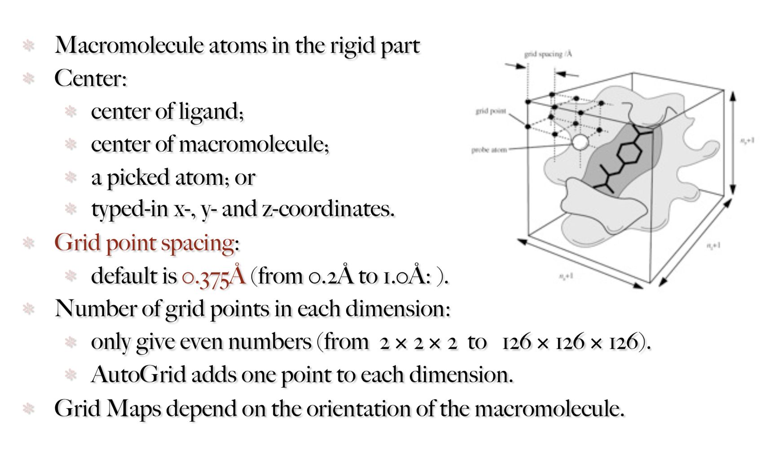
Setting up the AutoGrid Box

Slide 14
Setting up the AutoGrid Box

Slide 15
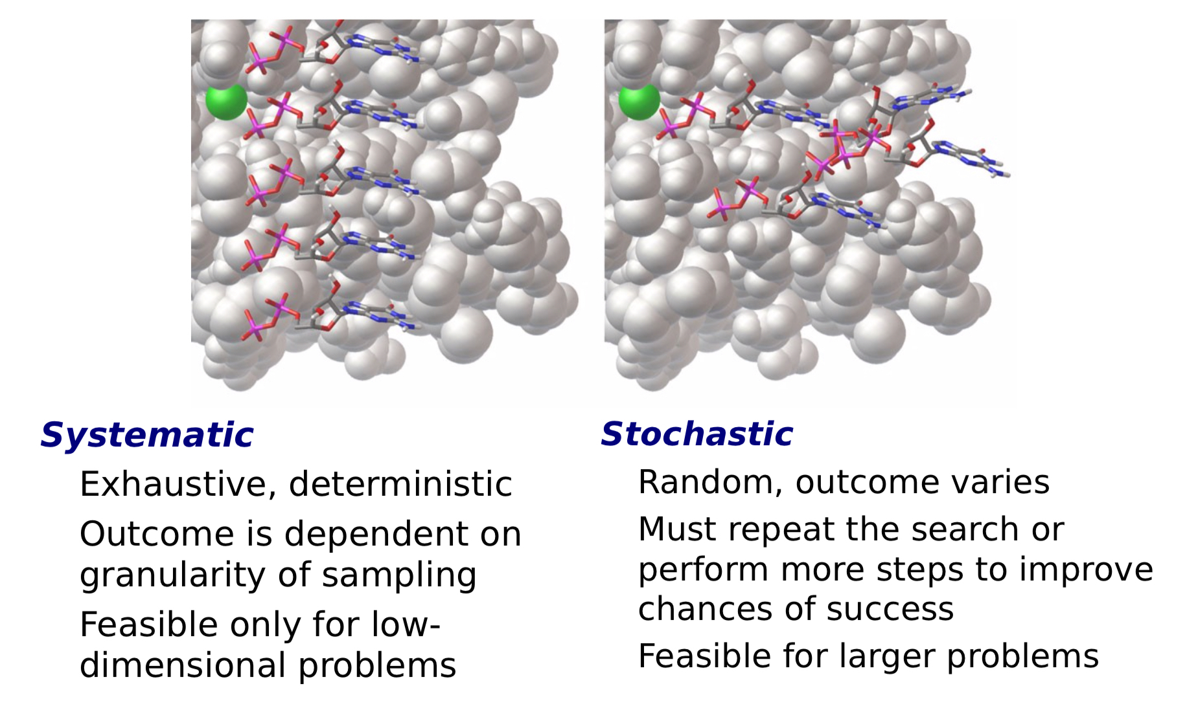
Two main types of searches in docking

Slide 16
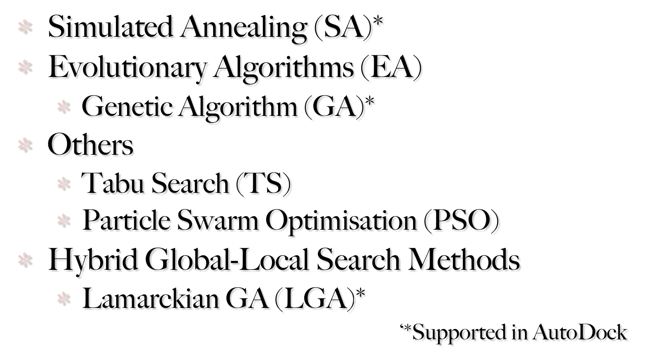
Stochastic Search Methods

Slide 17
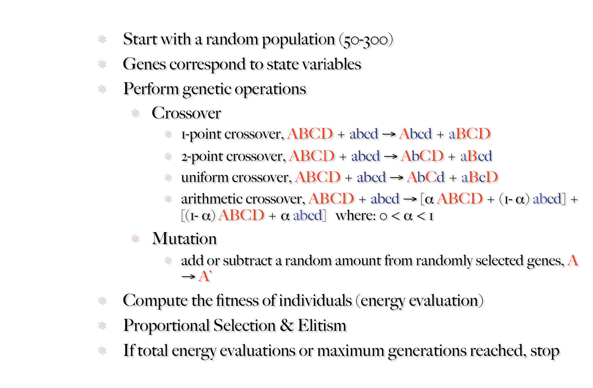
Genetic Algorithms

Slide 18
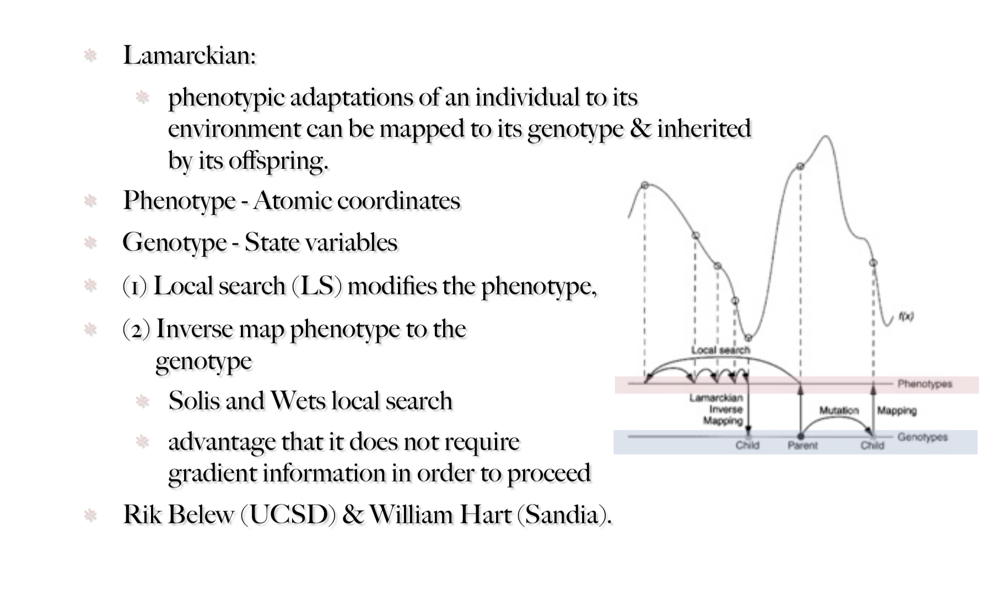
Genetic Algorithms

Slide 19
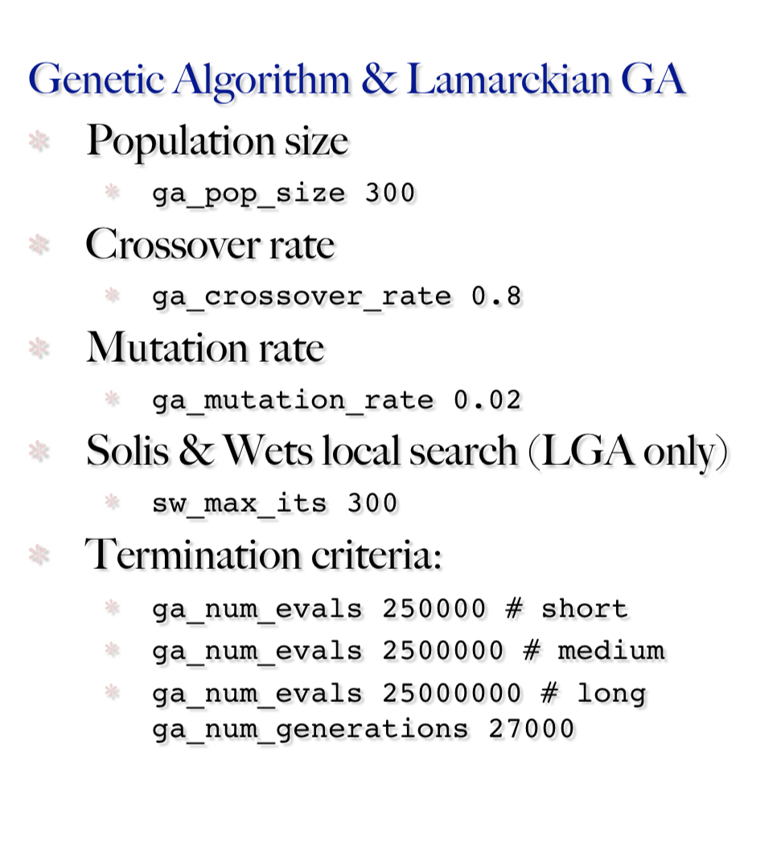
Important Genetic Algorithm search parameters

Slide 20
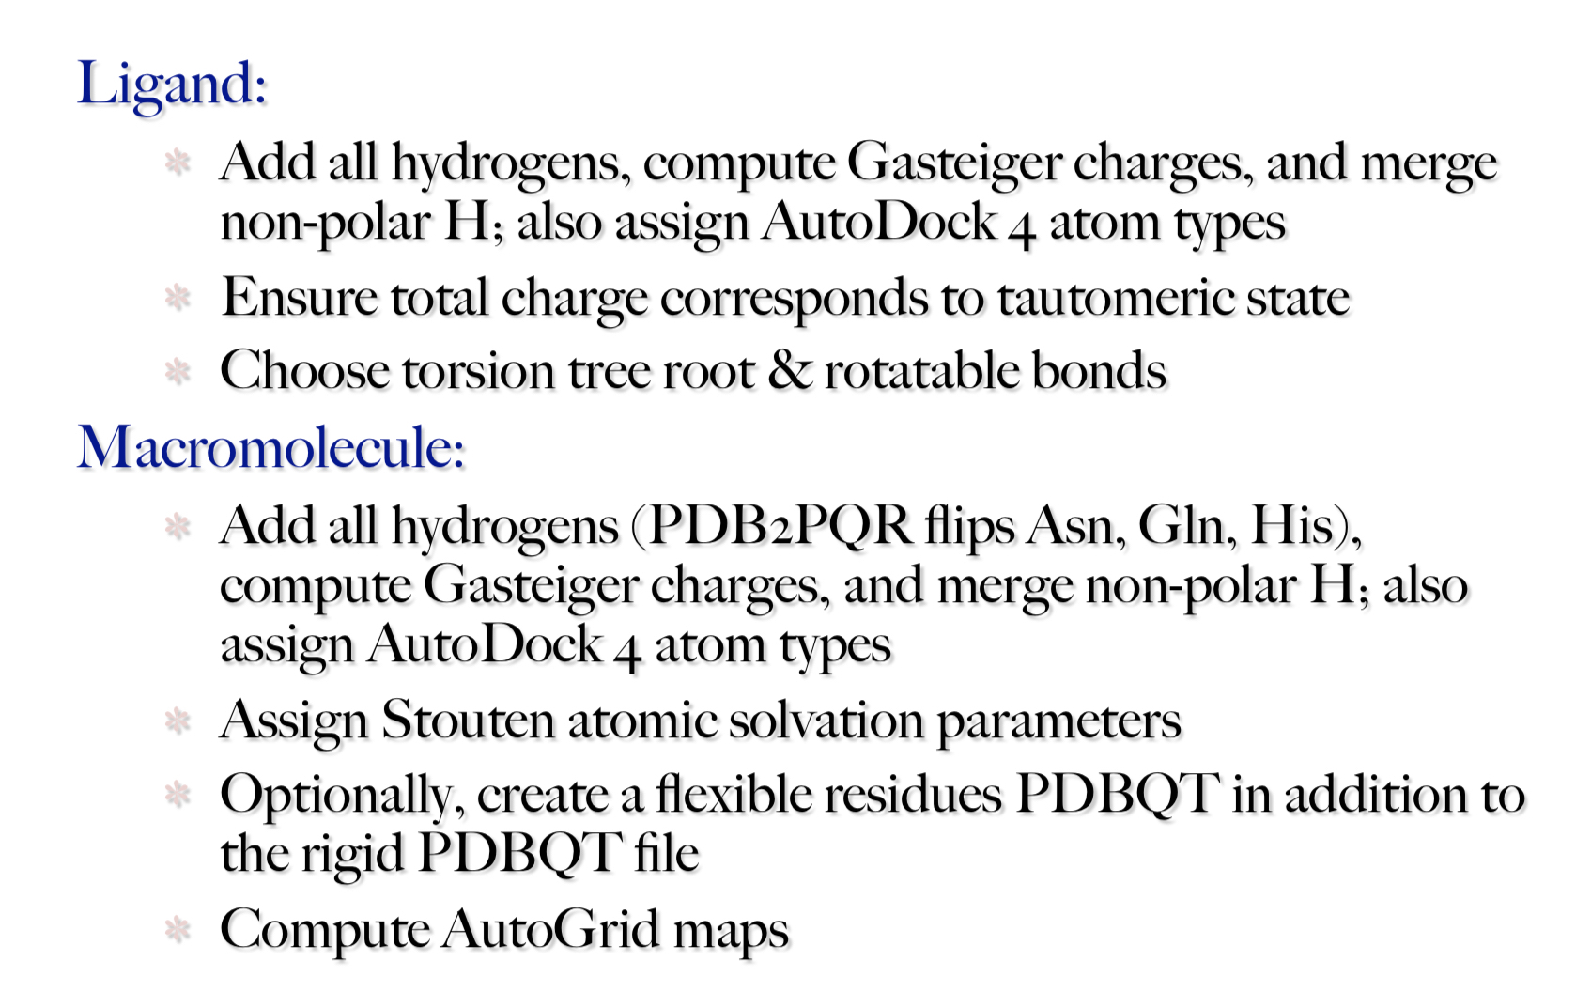
Things to do to setup an AutoDock 4 run

Slide 21
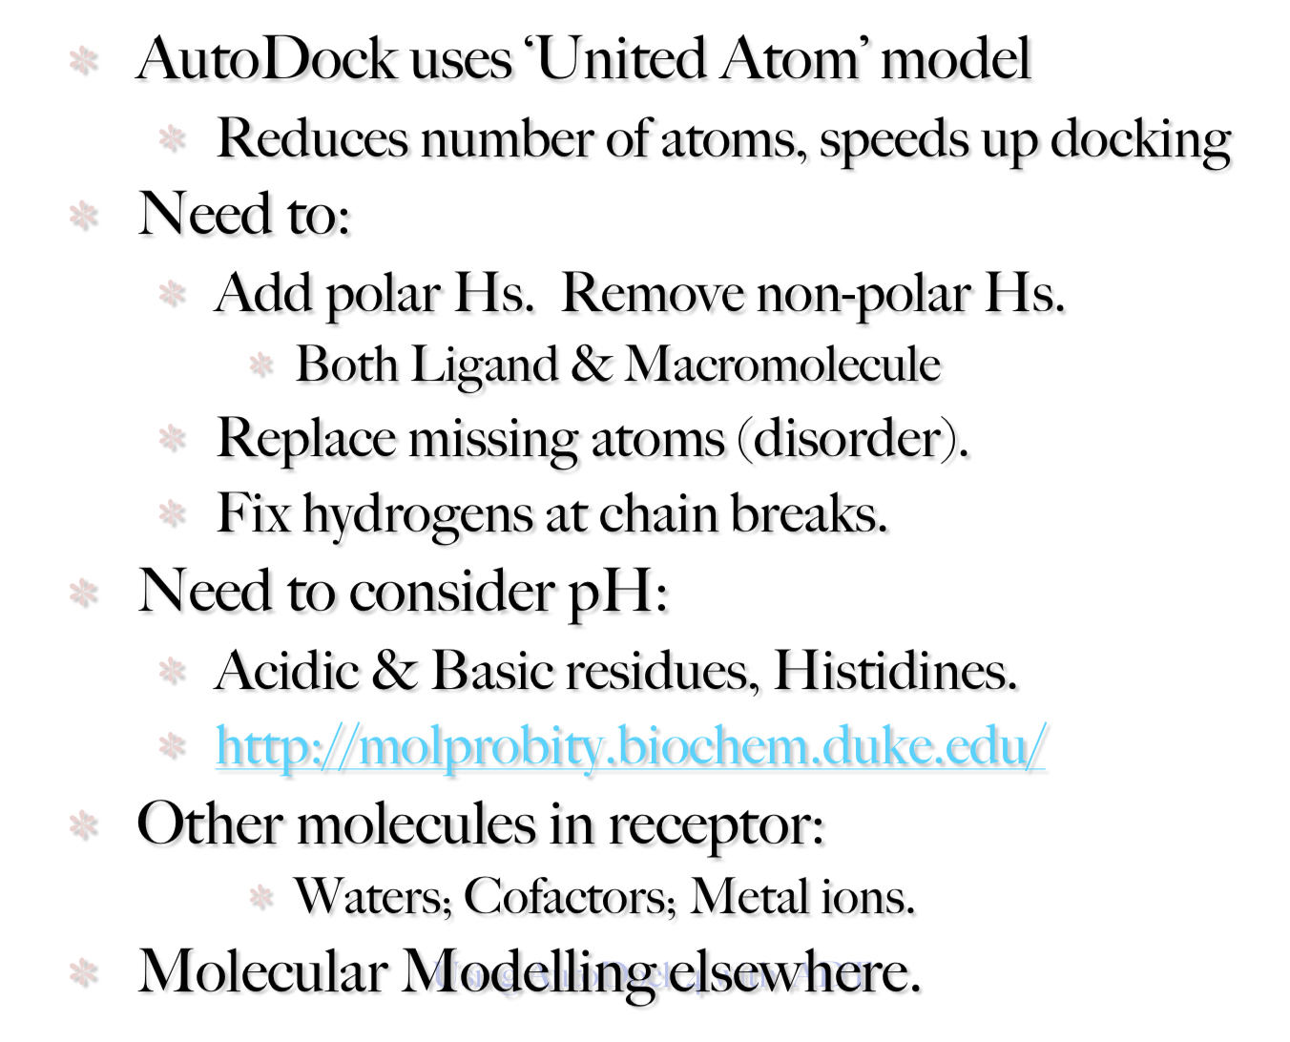
Preparing ligands and receptors

Slide 22
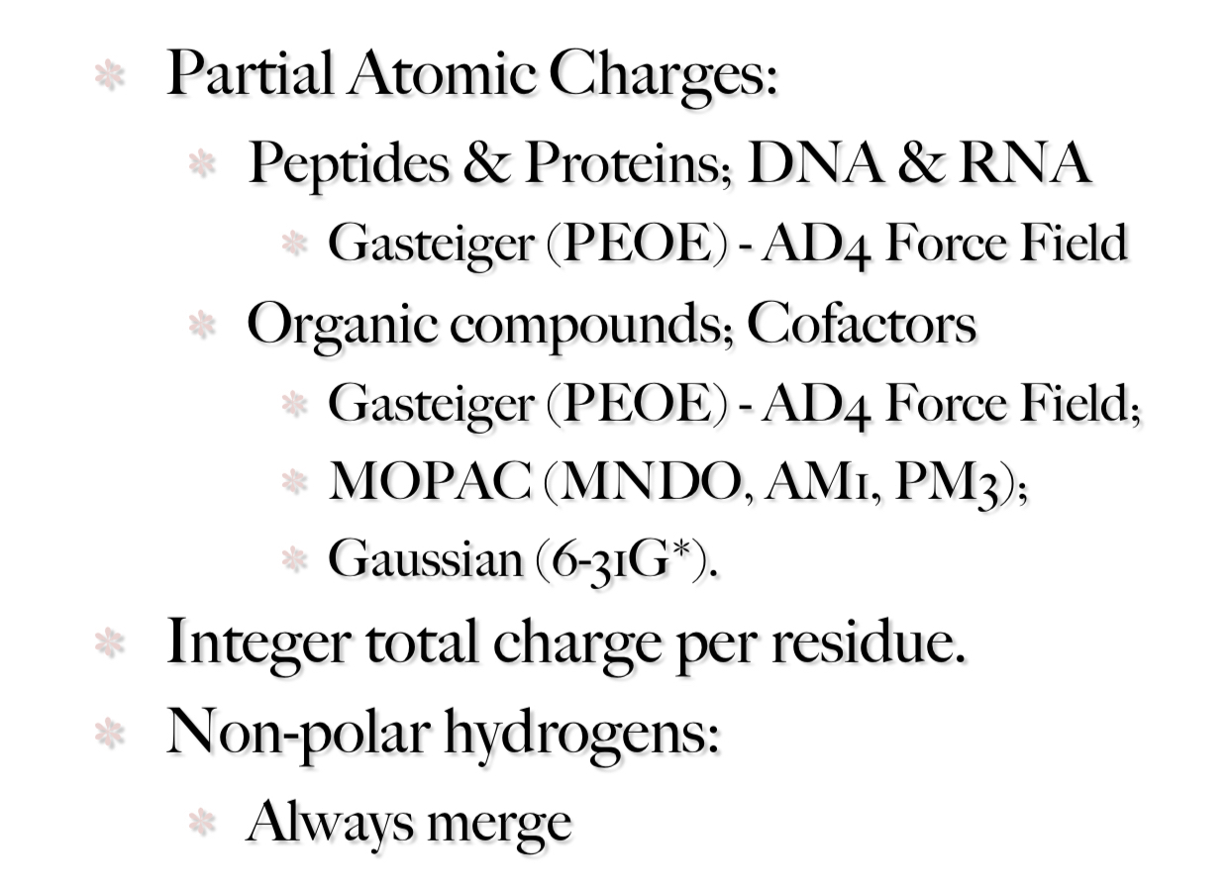
Partial charges are required for both
ligand and receptor

